Slide 1
Malignant Comment Classifier Project
By: K. Rahul Ramanujam

Slide 2
Problem Statement
Online forums and social media platforms have provided individuals with the means to put forward their thoughts and freely express their opinion on various issues and incidents. In some cases, these online comments contain explicit language which may hurt the readers.
Online hate, described as abusive language, aggression, cyber bullying, hatefulness and many others has been identified as a major threat on online social media platforms. Social media platforms are the most prominent grounds for such toxic behaviour.
To protect users from being exposed to offensive language on online forums or social media sites, companies have started flagging comments and blocking users who are found guilty of using unpleasant language.

Slide 3
Contd…
Our aim in this project is to focus mainly on data pre-processing and feature engineering and ensure that the data, which will be consumed by our machine learning models, is as clean as possible.
In addition, our goal is to build a prototype of online hate and abuse comment classifier which can used to classify good and offensive comments so that it can be controlled and restricted from spreading hatred and cyber bullying.

Slide 4
Data sources and formats
The dataset contains the training set, which has 1,59,571 samples and the test set which contains 1,53,164 samples. Training dataset contain 8 features which includes Id, Comments, Malignant, Highly malignant, Rude, Threat, Abuse and Loathe. While test dataset contain 2 features which include Id and Comments.
The label can be either 0 or 1, where 0 denotes a no while 1 denotes a yes. There are various comments which have multiple labels. The first attribute is a unique ID associated with each comment.

Slide 5
Problem Solving Approaches
Below is the approaches that we used in solve the issue and make the best model:
Data reading and understanding
Data analysis
Data cleaning and preparation
Over sampling
Train test split
Machine learning algorithms

Slide 6
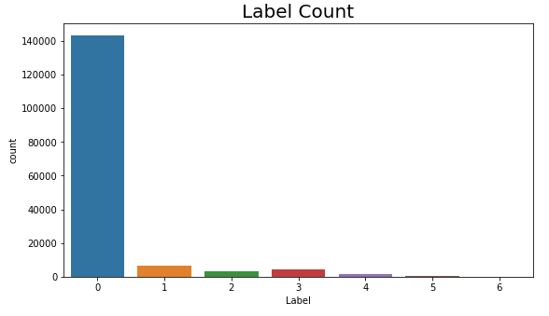
Data Analysis
From the count plot we can say that, most of the comments are good and very less numbers of comments are toxic. 0 depicts good comments, while 1, 2, 3, 4, 5 and 6 depicts offensive comments (All are the target columns).

Slide 7
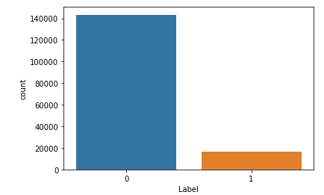
Contd…
From the count plot we can see that, after merge all target columns, data is looks like imbalanced. So, to solve this issue we used oversampling (SMOTE) method.

Slide 8
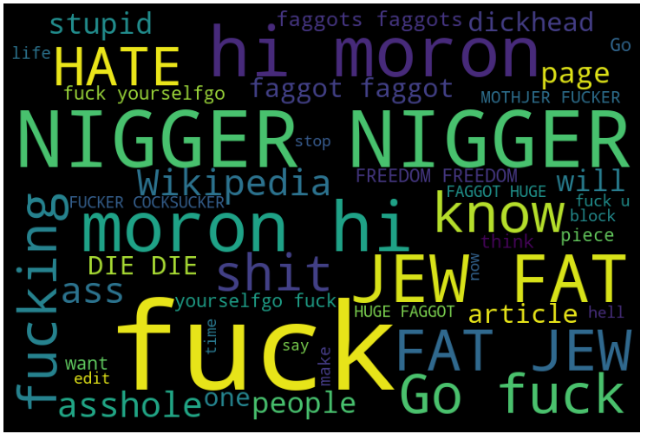
Contd…
This Wordcloud is for abuse comments in label column. This Wordcloud is highlight popular words and phrases based on frequency and relevance.

Slide 9
Data Cleaning and Data Preparation
For cleaning and preparation of the data, we use some techniques which are described below:
We check null values present in the data, but there is no null value found in the dataset.
There are six target features in this dataset so we combined them and make one target feature giving the name as label and also we do scaling for that feature.
After data analysis, we clean our data using some NLP (Natural Language Processing) techniques. We convert comments text column in lower case and remove punctuation from that column like +, - , /, etc. because that type of punctuation badly affect our result. Then we remove digits from comments text.

Slide 10
Contd…
After that, we apply stop words and lemmatization techniques on comments text.
Stop words are common words that structure a sentence. Words such as “I”, “are”, and “here” do not contribute to the sentiment (the rating in our case) of reviews. Hence, we decided to remove stopwords.
Lemmatization is the process of converting a word to its base form. Lemmatization usually refers to doing things properly with the use of a vocabulary and morphological analysis of words, normally aiming to remove inflectional endings only and to return the base or dictionary form of a word, which is known as the lemma. We applied this method on our comments text.

Slide 11
Contd…
At last, we use tf-idf and oversampling (smote) techniques for preparation of the data.
tf-idf is a method to encode data into numerical form, but carries more information than just the number of occurrences. TF-IDF is a numerical statistic that also reflects how important a word is to a document or paragraph. We convert our comments text into vectors using TF-IDF method.
we used SMOTE method to cop up with imbalanced classification of target column. This method creates synthetic samples (not duplicate) of minority class.

Slide 12
Train test split
we split our dataset into two segments: training and testing. We take 80% data for training and 20% data for testing. For splitting data we use train test split method. Below is the code for splitting the data:
80% of the observation as training set = x_train
The associated target for each observation in x_train = y_train
20% of the observation as test set= x_test
The target associated with the test set = y_test.

Slide 13
Testing of identified approaches
The classification algorithm that we used is:
Logistic Regression
Decision tree classifier
MultinomialNB
Random Forest Classifier
Gradient Boosting Classifier
Xgboost Classifier
Catboost Classifier

Slide 14
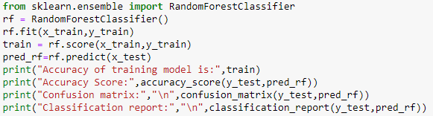
Building machine learning model
We use many algorithms to find best model, but here we describe only best model.
We find random forest classifier as a best model. It is supervised learning algorithm. This classifier produces multiple decision trees and merges them together to produce accurate result. Below is the code of our model with random forest classifier:

Slide 15
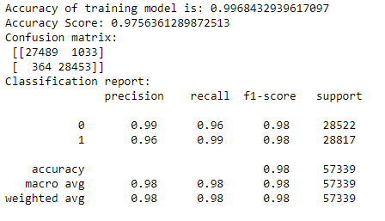
Contd…
Output:
We get 99% training model accuracy and 97% test data accuracy with best confusion matrix and classification report. As we can see in output, Randomforest classifier also gives good precision and recall score along with f1 score.

Slide 16
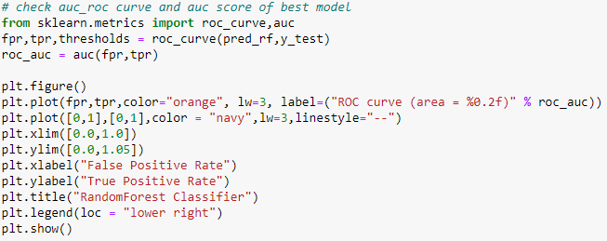
Contd…
Then, we check auc_roc score and plot auc curve of random forest classifier model. Area Under the Curve (AUC) is the measure of the ability of a classifier to distinguish between classes and is used as a summary of the ROC curve. The higher the AUC, the better the performance of the model at distinguishing between the positive and negative classes. Below is the code of auc_roc curve:

Slide 17
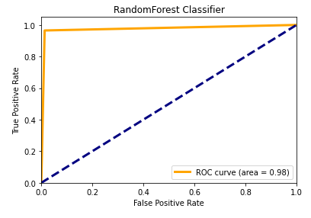
Contd…
Output of the code:
From the above plot we can see that, we get best area under the curve for randomforest classifier, which is 98%.

Slide 18
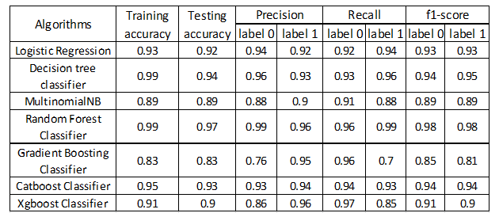
Contd…
Now, check accuracy of all used algorithms:

Slide 19
Conclusion
The purpose of this article was twofold: to understand the pattern of various types of comments and make predictive model able to effectively classify observation in the two classes, i.e. 0 (good comments) and 1 (offensive comments)
Our target variable is imbalanced, so we use SMOTE technique to get a good result.
We use many classifiers to find best model and best result were observed for the random forest classifier with 97% accuracy score. We also get a good precision and recall score along with f1-score.
Our model is able to detect offensive comments with very high confidence.

Slide 20
Thanks

